Slide 2
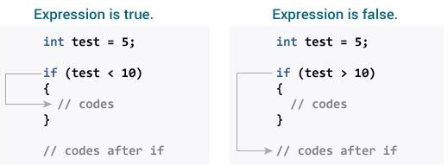
How if statement works?
The if statement evaluates the test expression inside the parenthesis ().
If the test expression is evaluated to true, statements inside the body of if are executed.
If the test expression is evaluated to false, statements inside the body of if are not executed.

Slide 3
EXAMPLE PROGRAMME
#include <stdio.h> int main()
{
int number;
printf("Enter an integer: "); scanf("%d", &number);
// true if number is less than 0 if (number < 0)
{
printf("You entered %d.\n", number);
}
printf("The if statement is easy."); return 0;
}
Output:
Enter an integer: -2 You entered -2.

Slide 4
IF ELSE STATEMENT
How if...else statement works?
If the test expression is evaluated to true, statements inside the body of if are executed. statements inside the body of else are skipped from execution.
If the test expression is evaluated to false, statements inside the body of else are executed statements inside the body of if are skipped from execution.

Slide 5
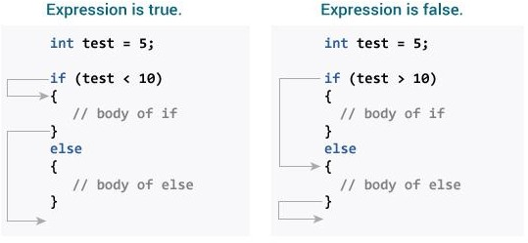

Slide 6
if...else statement
// Check whether an integer is odd or even #include <stdio.h> int main()
{
int number;
printf("Enter an integer: "); scanf("%d", &number);
// True if the remainder is 0 if (number%2 == 0)
{
printf("%d is an even integer.",number);
}
else
{
printf("%d is an odd integer.",number);
}
return 0;
}
Output
Enter an integer: 7 7 is an odd integer.

Slide 7
IF ELSE ELSE IF
The if...else statement executes two different codes depending upon whether the test expression is true or false. Sometimes, a choice has to be made from more than 2 possibilities.
The if...else ladder allows you to check between multiple test expressions and execute different statements.
Syntax of nested if...else statement.
if (test expression1)
{
// statement(s)
}
else if(test expression2)
{
// statement(s)
}
else if (test expression3)
{
// statement(s)
} . .
else {
// statement(s) }

Slide 8
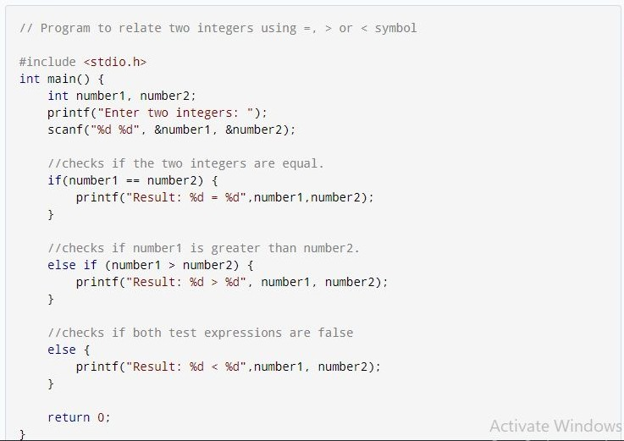

Slide 9
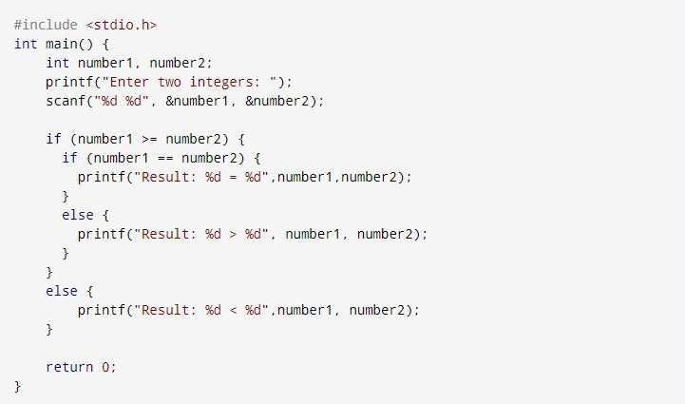
Nested if...else
If an if else statements contain another if else statement inside it is called if nested if statement.

Slide 10
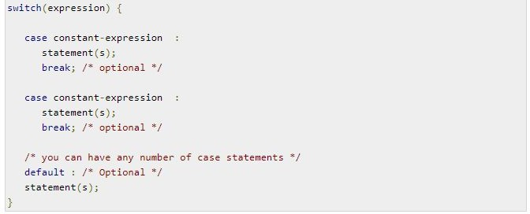
SWITCH STATEMENT
Syntax:
The syntax for a switch statement in C programming language is as follows −

Slide 11
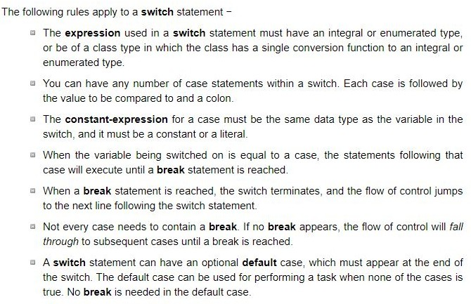

Slide 12
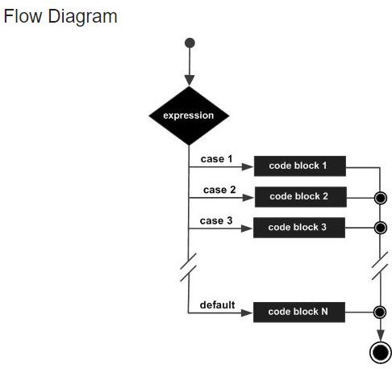

Slide 13
